Slide 1
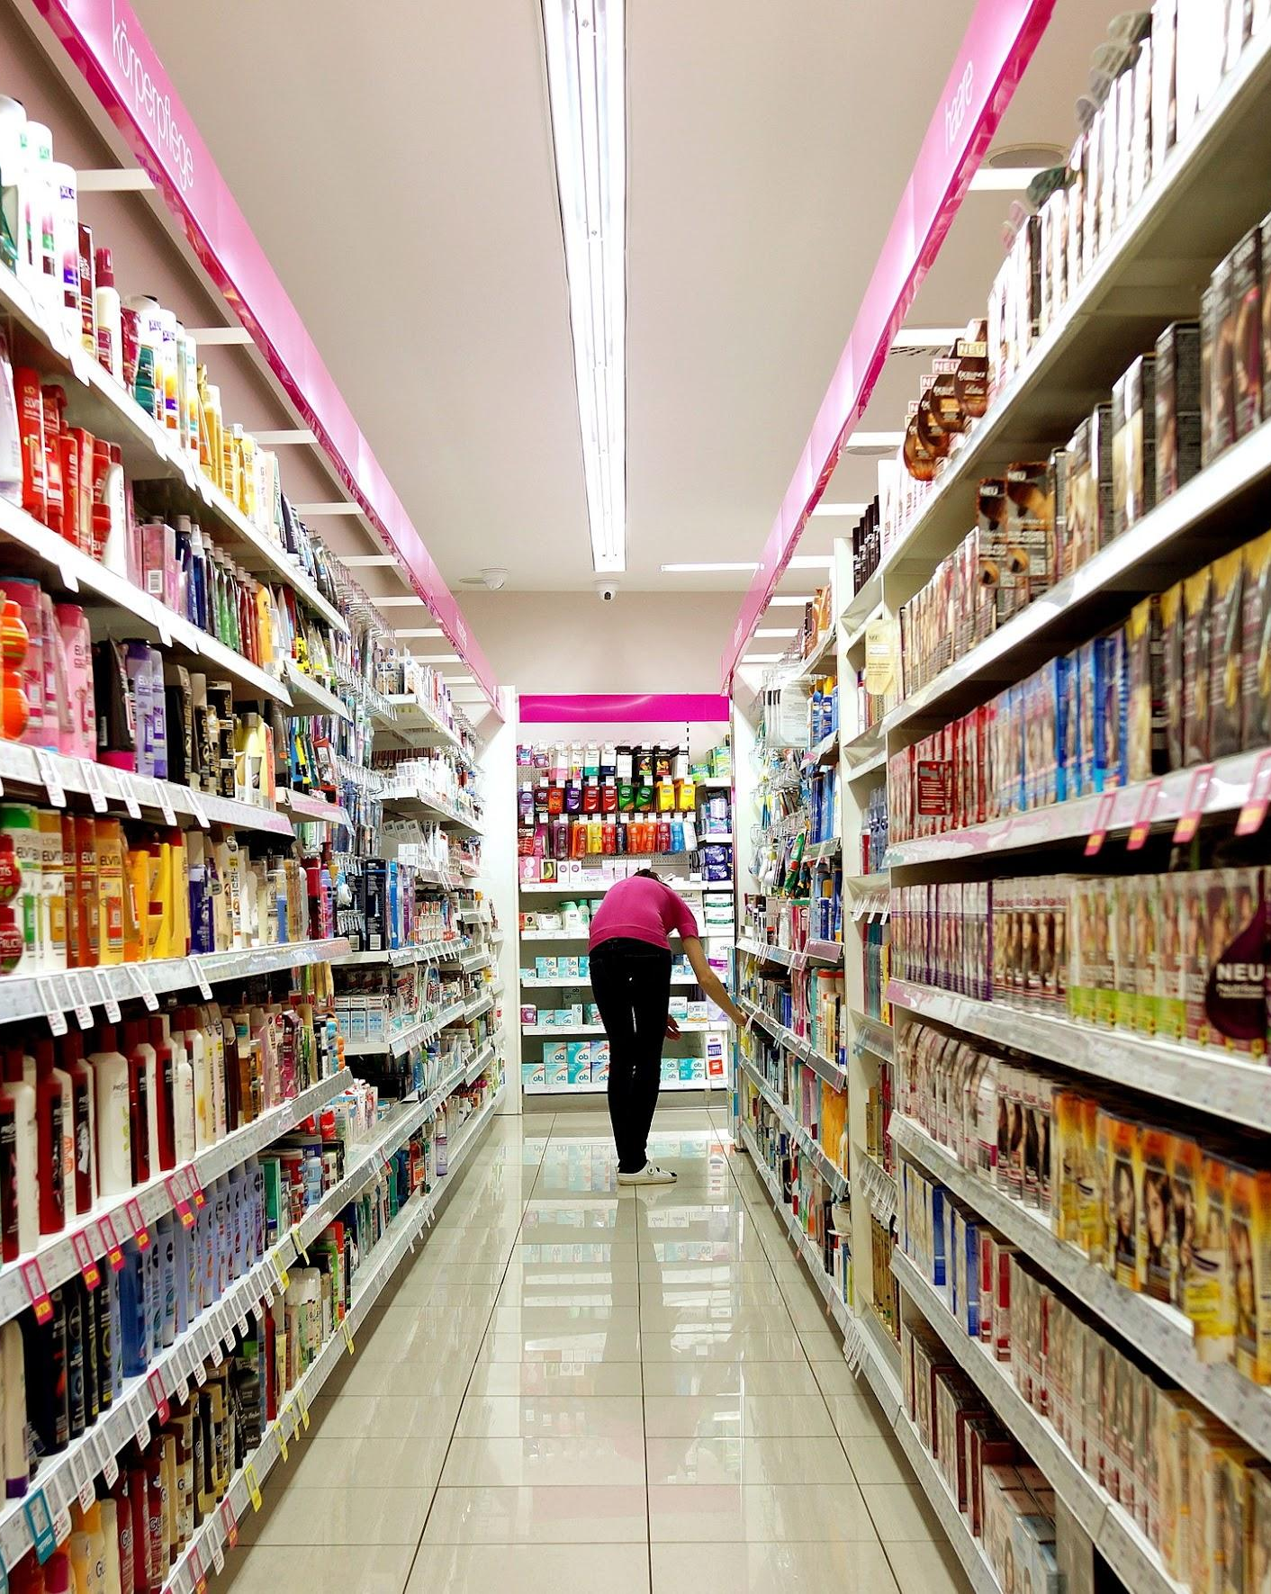
Analysis of Supermarket Sales
Room 12
Rainier N
Mayank Pratap S
Sophia J
Abhaya Chetna J

Slide 2
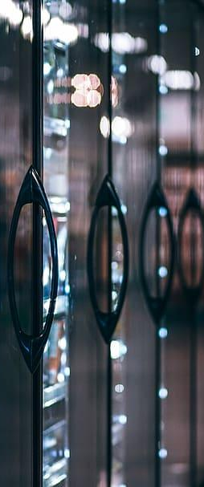
INTRODUCTION
1

Slide 3
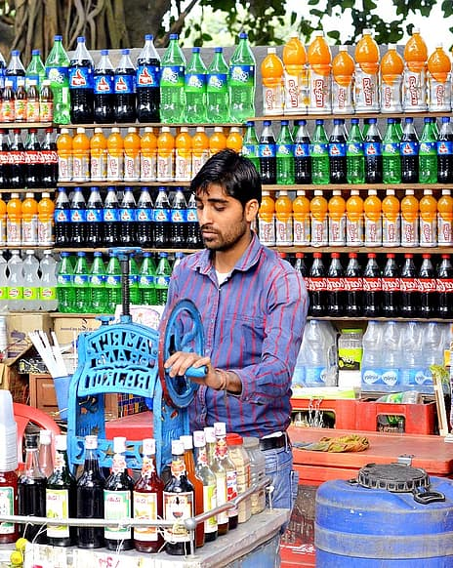
Myanmar
From the Southeast Asia
Diverse country
Common destination for Buddhists
Notes:
To start off, let us take a look at one of the countries that has been featured in in our presentation and dataset.
Myanmar
What do we know about Myanmar
It is from the southeast asia
Diverse countries with a lot of ethnic groups
Common destination for Buddhists
However, we believe that there are still a lot of aspects to improve for this country in terms of their people being heard in their needs.

Slide 4

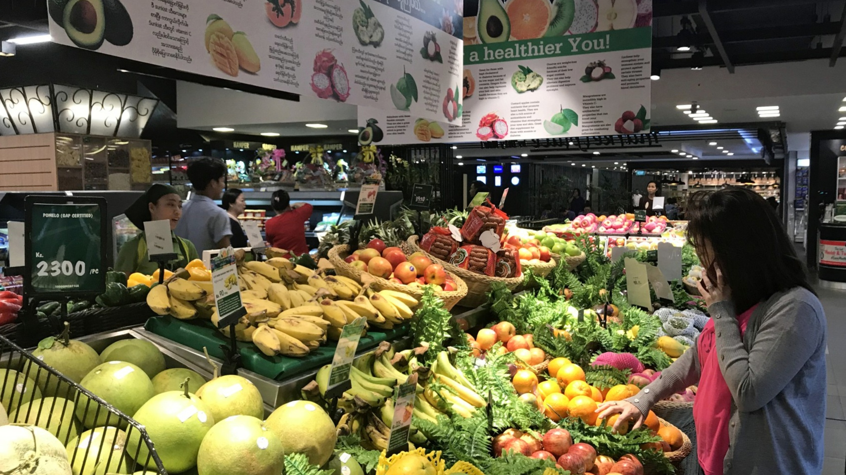
Featuring…
Yangon
Largest city in Myanmar
Famous for its colonial architecture
Notes:
We would also like to give a bg about the 3 cities that are featured in Myanmar
Yangon

Slide 5

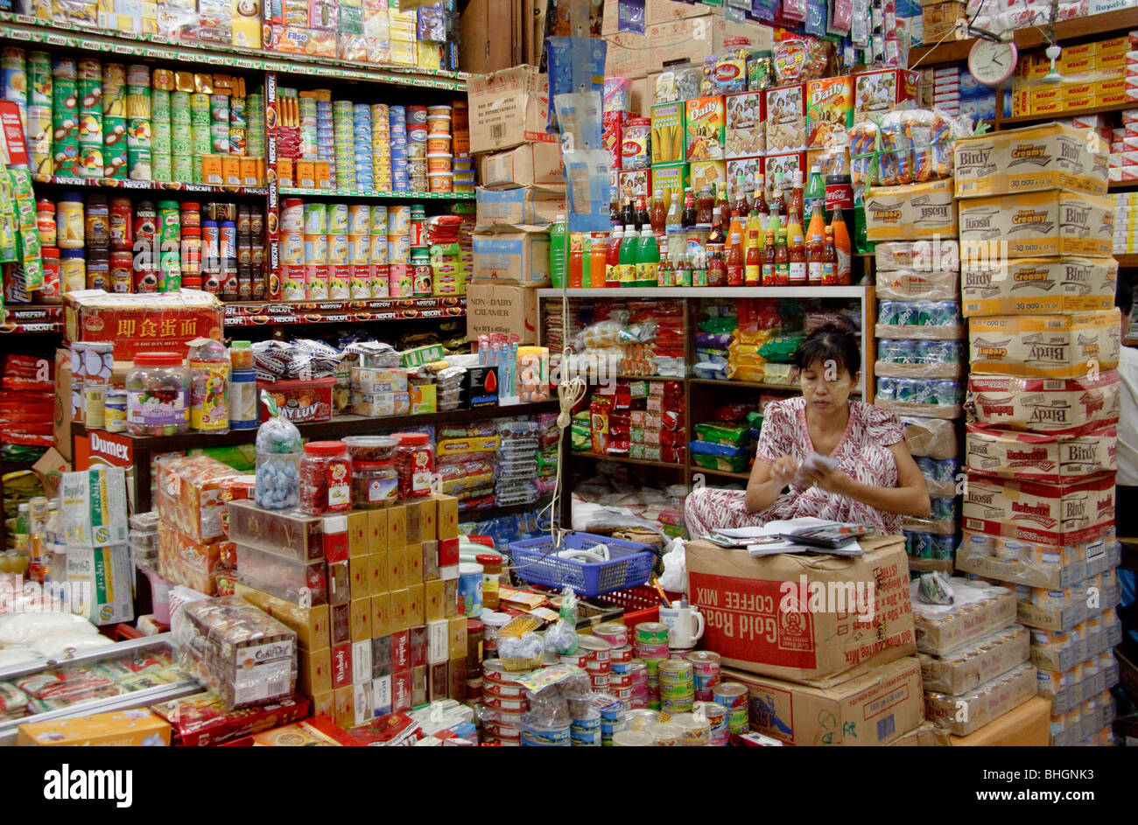
Featuring…
Mandalay
Best known for its Buddhist temples
Notes:
Mandalay

Slide 6
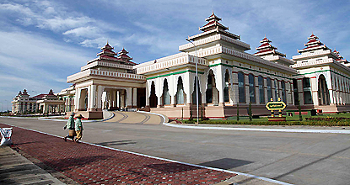
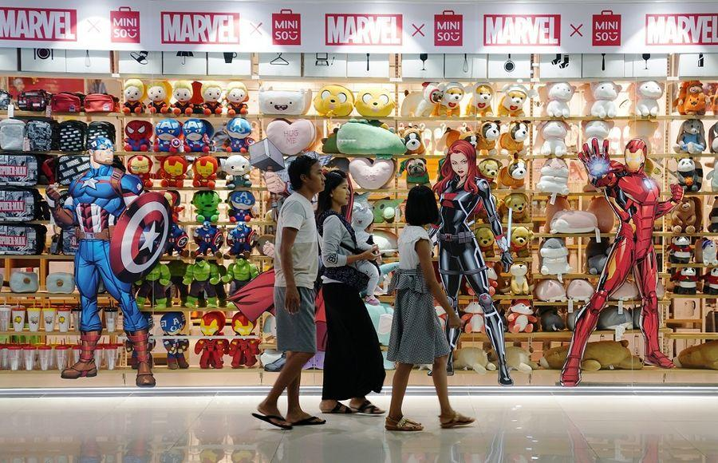
Featuring…
Naypyitaw
Modern capital of Myanmar
Seat of government headquarters
Notes:
Naypyitaw
Although there are a lot of good aspects in Myanmar , we believe that there are still a lot of aspects to improve in terms of their people being heard in their needs.

Slide 7
Supermarkets provide almost all the goods of daily and regular needs to the consumers under one roof
Let’s take a look what we can learn from this on how other supermarkets / industries can also thrive today.
Notes:
In our presentation, the said 3 cities are highlighted in terms of its sales of supermarkets which we believe plays an important role in these cities in terms of serving their people as supermarkets provide almost all the goods of daily and regular needs to the consumers under one roof.
The growth of supermarkets in most populated cities are increasing and market competitions are also high. With this, Let’s take a look what we can learn from this on how other supermarkets / industries can also thrive today as we’ve tried different methods of analytics are presented.

Slide 8

Our Collaboration Process
Looking for common interests
Getting an overview of the data
Creating questions and creating hypotheses
Finding and visualizing the answers to our questions

Slide 9
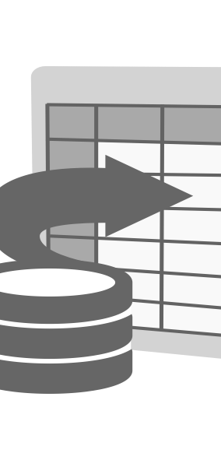
About the Dataset
Supermarket Sales Dataset
Source:
https://www.kaggle.com/datasets/aungpyaeap/supermarket-sales
This contains 1000 records of sales data for three months across three branches of supermarkets in Myanmar.

Slide 10
The dataset contains information about the following:
Branch
City
Customer Type
Gender
Product Line
Date and Time of purchase
Method of Payment
Price details and Ratings

Slide 11
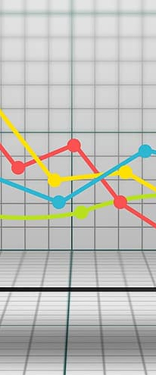
CHARTS & INSIGHTS
2

Slide 12

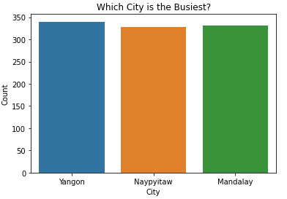
Which supermarkets are the busiest?

Slide 13
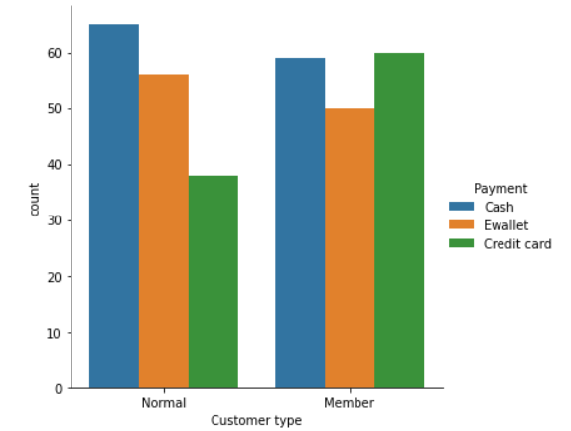
Which payment method is most used?

Slide 14
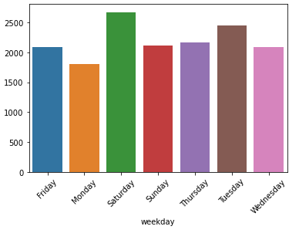
Which days are most profitable for the supermarket?

Slide 15
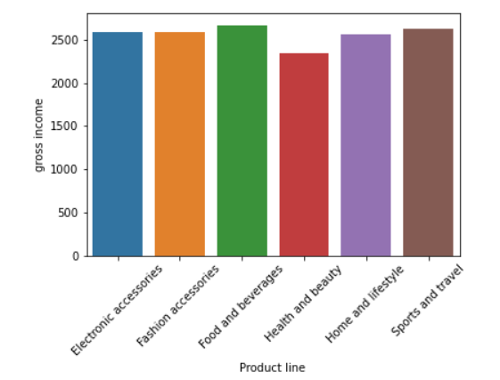
Which product lines sold the most?

Slide 16
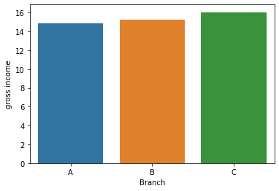
Which branch had the greatest gross income?

Slide 17
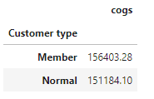
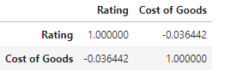
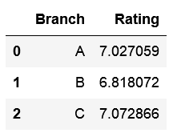
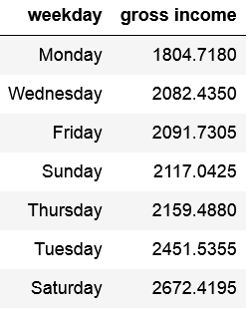
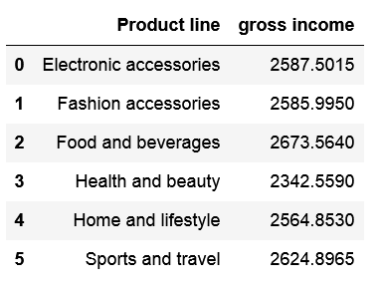
Interesting insights

Slide 18

Problems Encountered
Data is likely fabricated
Some initial questions lead to uninteresting answers

Slide 19

CODE
3

Slide 20

How we did it:
Used the knowledge from the recent Nueda sessions.
Data Cleaning
Data Analysis
Data Visualization
Using Pandas, Numpy, Matplotlib, etc.

Slide 21
How it looks like!
Show code now!

Slide 22
RECOMMENDATIONS & CONCLUSION
4

Slide 23
Recommendations
Data
Look at what people have already done (Kaggle).
Try to do more analysis with respect to Date and time.
Supermarkets
Prioritization on most profitable product types (i.e. in promotions)

Slide 24
Conclusion
Analysis of Supermarket Sales
Business Understanding - Laying down context
Question/Hypothesis - What do we want to know?
Data Preparation - Data Cleaning, Data Exploration
Data Analysis - Grouping datasets, Comparisons
Data Visualization - Charts, Tables
Insights - What does the data tell us?

Slide 25
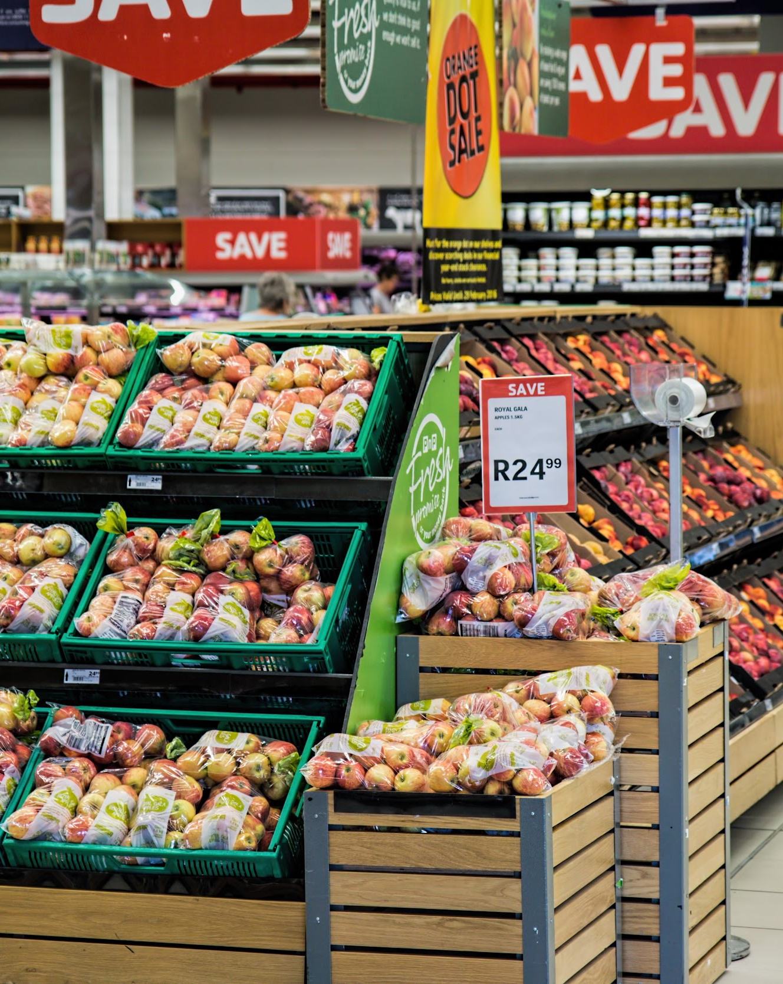
Question and Answers!

Slide 26
Thank you!

